Slide 1
Auditing Membership Leakages of Multi-Exit Networks
Zheng Li¹, Yiyong Liu¹, Xinlei He¹, Ning Yu², Michael Backes¹, Yang Zhang¹
CISPA Helmholtz Center for Information Security
Salesfore Research

Slide 2
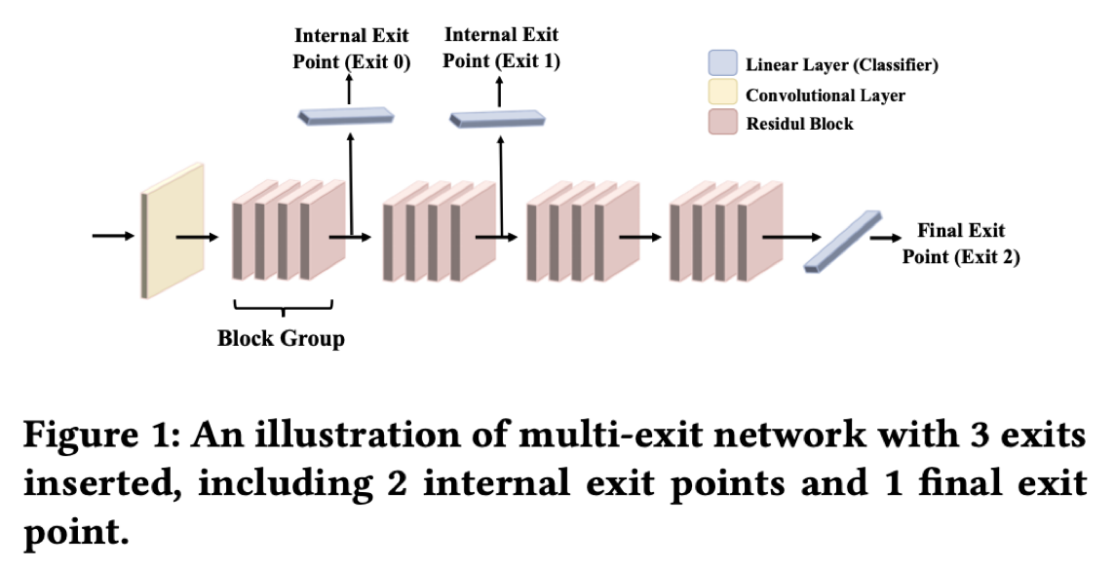
Multi-Exit Network
Backbone Model
Applications:
real-time constraints in robotics, e.g., self-driving cars.
improve energy efficiency, e.g., mobile devices.
Notes:
First, let me introduce background of multi-exit networks
Multi-exit networks are recently getting attention because of its low latency and high energy efficiency.
It consists of a backbone model and multiple exit points at different positions.
The backbone models can be standard convolutional networks, such as VGG [54], ResNet [17], and MobileNet [50].
These exits points are lightweight classifiers.
How does it work, Given a input, we first get the prediction from the first exit, and compare it with a pre-defined threshold, if the prediction is larger than threshold, we will stop here and give the predicton, otherwise go to the next predciton.
In this way, we can reduce the energy cost and inference time.
It can be used in many critical applications, such as self-driving cars or mobile devices.

Slide 3
Motivation
Current designs of multi-exit networks are only considered to achieve the best trade-off between resource usage efficiency and prediction accuracy;
The privacy risks stemming from them have never been explored.
We take the first step to audit the privacy risks of multi-exit networks through the lens of membership inference
Notes:
However, current various designs of multi-exit networks are only considered to achieve the best trade-off between resource usage efficiency and prediction accuracy, the privacy risks stemming from them have never been explored.
In this work, we take the first step to audit the privacy risks of multi-exit networks through the lens of membership inference. More specifically, we focus on machine learning classification.

Slide 4
Membership Inference Attack
Training
0.1
0.8
0.1
0.0
panda
cat
dog
bird
Privacy risks: An ML model for medical diagnosis, if a person is in the training set, then he/she carries the disease.
Notes:
So what is membership inference attack.
Membership inference attacks means that an adversary aims to determine whether a data sample is part of the training set.
So why does this attack matter?
The reason is that it can cause privacy risk, For example, if a machine learning model is for medical diagnosis, and we can determine a person in the training set, then we can know that the person carries the disease.

Slide 5
Quantify Membership Leakage Risks
Notes:
In first contribution of this work is that we quantify the membership leakage risks of multi-exit networks by using existing attack methods

Slide 6
Existing Membership Inference Attacks
Feature
Gradients
Confidence Score
Member
Or
Non-member
Member
Or
Non-member
Member
Or
Non-member
Confidence Score
Predicted Label
Loss
Ground truth label
Gradient-based
Score-based
Label-only
Notes:
We here outline the threat models considered in this work. There are three existing categories of scenarios, i.e., gradient-based/score-based/label-only.
Gradient-based attacks also called white-box attack means that we can access to the all the information of the model, such as gradients internal and so on.
Score-based attacks means that we can access to the confidence score returned by the model,
in contrast, the label-only attack means that we can only access to the final predicted labels.

Slide 7
Results
Multi-exit model performs similarly with the vanilla model on the classification task, but better in computational cost
Notes:
Before our evaluation results, here we show that the multi-exit model performs similarly with the vanilla model on the classification task, but is much better in terms of computational cost.

Slide 8
Results
Multi-exit networks are less vulnerable to membership inference attacks
Notes:
Here we report attack success rate.
We can observe that all the multi-exit models have lower attack success rate than the vanilla models
These results indicate that multi-exit networks are less vulnerable to membership inferece attacks.

Slide 9
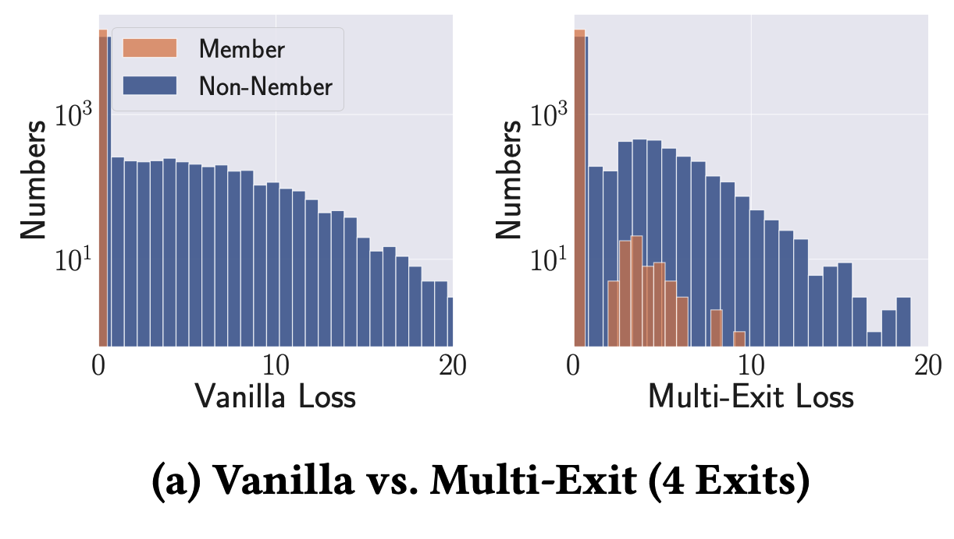
Results
The loss distribution difference of multi-exit networks is much lower
Notes:
For the reasons for why multi-exit is less vulnerable.
We analyze the loss distribution.
We can see that the multi-exit model has a much lower difference of the classification loss between members and non-members.

Slide 10
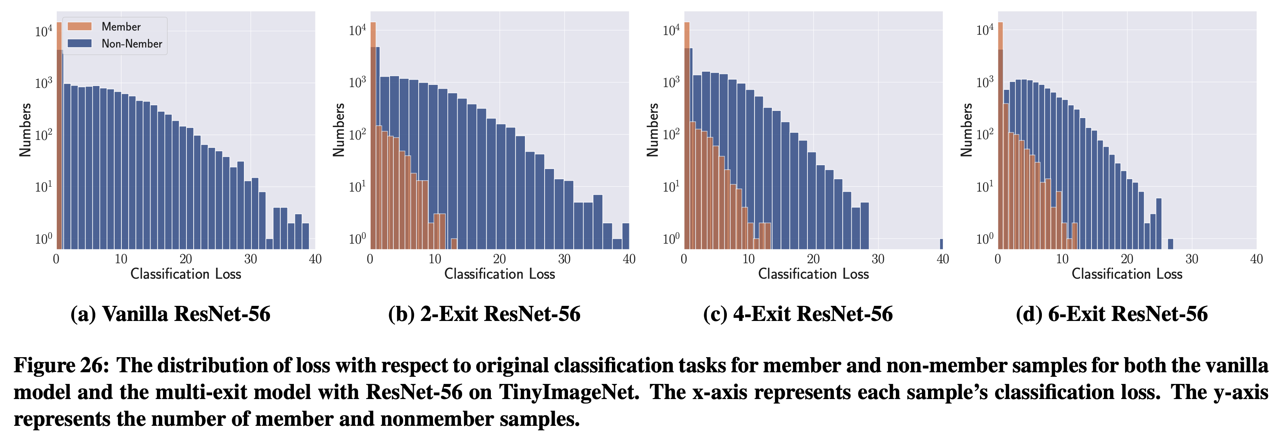
Results
The vulnerability to membership leakages is negatively correlated to the number of exits.
Notes:
Here we study the effect of the number of exits on membership leakage.
we can also find the model with more number of exits leads to lower difference between members and non-members. This indicates that The vulnerability to membership leakages is negatively correlated to the number of exits.
The reason is that more exits mean that more data samples leave at the earlier exit points than the final exit points, which makes the model less likely to be overfitted on the training set.

Slide 11
Results
The vulnerability to membership leakages is positively correlated to the exit index.
Notes:
We investigate the effects of the exit index of one multi-exit model.
As shown in this Figure, we can see that the loss difference of members and non-members increases with the exit index. These results indicate that the vulnerability to membership leakages is positively correlated to the exit index, that is to say, the samples leaving from deeper exit points are easier to be distinguished between members and non-members.
The reason for this observation is that deeper exit points imply higher capacity models, which are more likely to be overfitted to the members.

Slide 12
Hybrid Attack
Notes:
Based on the observation that attack performance is highly correlated with exits information.
In the next part, we propose a hybrid attack that exploits the exit information as new knowledge for the adversary.

Slide 13
Hybrid Attack
Threat Model: the adversary cannot access any exit information.
Methodology:
Hyperparameter stealing: steal the exit information.
Leveraging the stolen exit information: enhanced membership inference
Notes:
Here, we consider a realistic scenario where the adversary cannot access any exit information, and can only get the confidence score or predicted label.
And the methodology can be organized into two stages: hyperparameter stealing which aims to steal the exit information and leverage the stolen exit information to improve the attack performance .

Slide 14
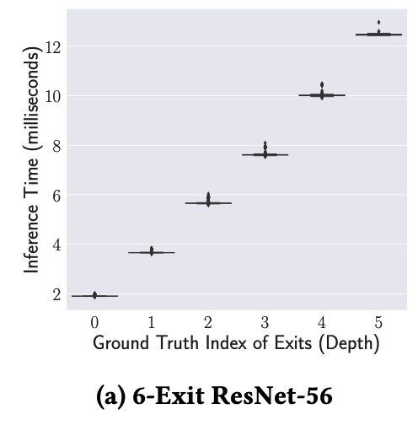
Hybrid Attack (Adversary 2)
Hyperparameter Stealing
Notes:
As its backbox scenario where we cannot access the exit index, but we know that the inference time of each exit point is different, as shown in this figure.
That is to say, data samples leaving at deeper exit points imply longer inference times.
So we can leverage the different inference time to infer the exit index.

Slide 15
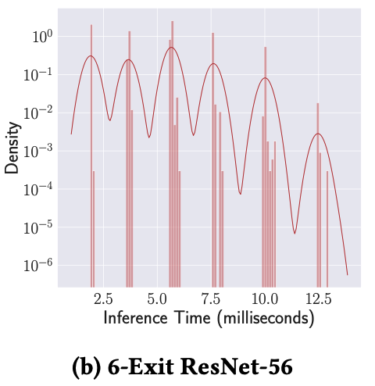
Hybrid Attack (Adversary 2)
Target Model
10000 random samples
query
output
Inference time
[0.71, 0.72, 1.53, 0.71, …, 4.8], length = 10000
KDE (Kernel Density Estimation)
A new inference time, e.g., 3.21ms
2.7 4.6 6.7 8.5 11.5
Hyperparameter Stealing
Exit Index = 1
The number of exits = 6
Notes:
The attacker first queries the target multi-exit model using a large number of data samples and records the inference time of these samples.
The attacker then sorts all recorded inference time as a one-dimensional data.
Here attacker leverage Kernel Density Estimation (KDE)[48] to cluster the one-dimensional data.
The right figure shows KDE fits the inference time with a smoothed line. Then, several minima of the smoothed line can be used to partition them into different clusters.
Thus the number of clusters means the number of exits, and the index of each cluster means the exit index.
Finally, given a new input, we can know it is from which exit index.

Slide 16
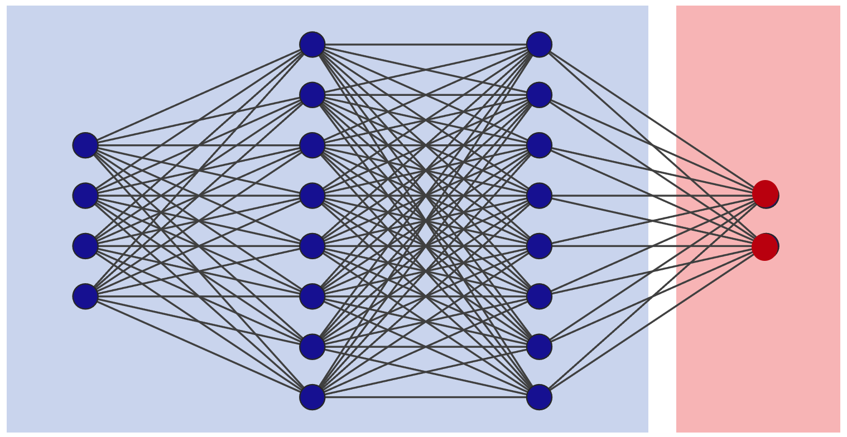
Hybrid Attack (Adversary 2)
Leverage the stolen exit information
Score-based: Attack model (binary classifier): one-hot encoding.
Label-only: performs the label-only attack of each exit point.
Attack Model
(Binary Classifier)
Existing Info
Exit info
[0,1,0,0,0,0]
Notes:
Then to leverage the stolen exit information,
For score-based attacks using binary classifier, given the exit number and index, the attacker first converts it to a one-hot encoding. They then provide the one-hot encoding of the exit information and other existing information to the attack model.
In the label-only scenario, the adversary first separates the data samples according to their exit index and then performs the label-only attack to distinguish members and non-members of each exit index.

Slide 17
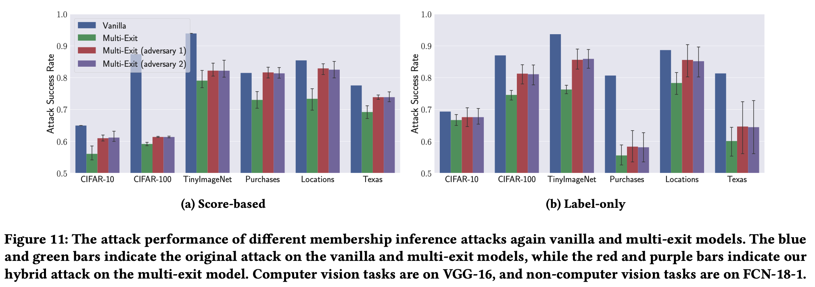
Hybrid Attack (Adversary 2)
Original Attack
Hybrid Attack
Our hybrid attack achieves remarkable performance.
Notes:
Here we report the attack performance,
Compared to the original existing attacks without the exit information, we can clearly find that our hybrid attack can achieve much better performance.

Slide 18
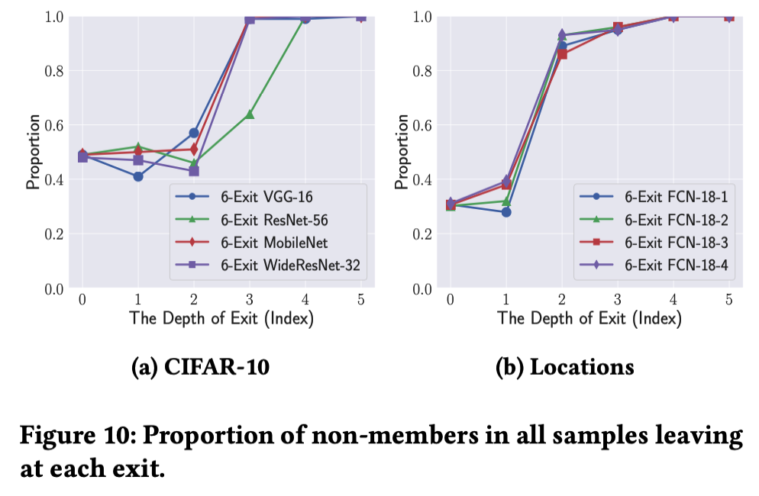
Hybrid Attack (Adversary 2)
Members likely exit early, while non-members exit late.
Notes:
Here, we study more deeply into the reasons for the success.
This figure shows, at each exit point, the proportion of nonmembers in all samples.
We can see that members likely exit early, while non-members exit late. In other words, if you know the sample leaves at the exit 5, we are very confident that the sample is a non-member.
Such separability of members/non-members in terms of exit index guarantees the effectiveness of our hybrid attack.

Slide 19
Conclusions
Multi-exit networks are less vulnerable to membership inference attack
Extra exit information can leaks more membership information.
More evaluations in the paper!
The effect of model architectures.
The effect of dataset distributions.
Defense TimeGuard.
…

