Slide 1
A Superpixel-Based Framework for Automatic Tumor Segmentation on Breast DCE-MRI
Ning Yu, Jia Wu, Susan P. Weinstein, Bilwaj Gaonkar,
Brad M. Keller, Ahmed B. Ashraf, YunQing Jiang,
Christos Davatzikos, Emily F. Conant, Despina Kontos

Slide 2
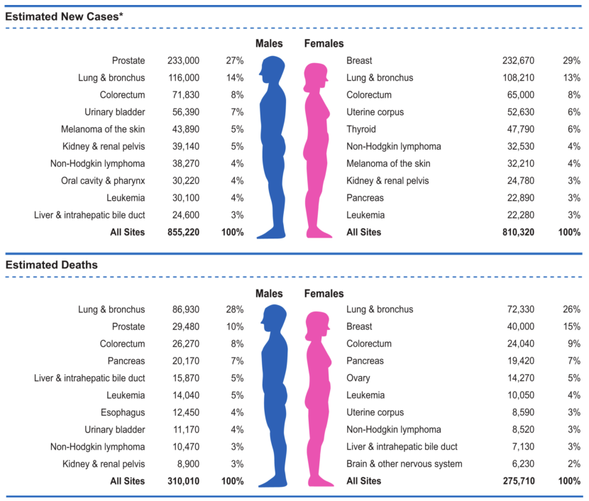
Introduction: Breast Cancer
Breast cancer:
Most commonly diagnosed cancer form in women in U.S.
Second leading cause of cancer deaths in women in U.S.
* R. Siegel, J. M. Ma, Z. H. Zou et al., “Cancer Statistics, 2014,” Ca-a Cancer Journal for Clinicians, 64(1), 9-29 (2014).
Notes:
Breast cancer is the most commonly diagnosed form of cancer in women and is the second leading cause of cancer deaths in women after lung cancer in the United States.

Slide 3
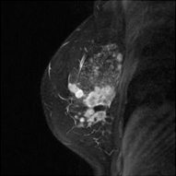
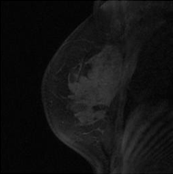
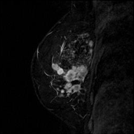
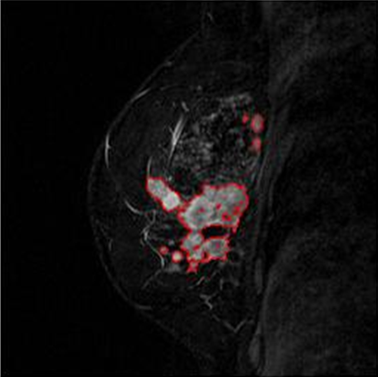
Introduction: DCE-MRI
manual
-
=
auto
post-contrast image
pre-contrast image
subtraction image
Preferred !
tumor boundaries in red
(input image)
tumor shrinks
tumor
before chemo
1st treatment
2nd treatment
after chemo
Notes:
In recent years, dynamic contrast-enhanced MRI (DCE-MRI) has become a widely recognized and commonly utilized modality for diagnosing and staging breast cancer.
DCE-MRI operates by acquiring pre-contrast images and post-contrast images separately before and after injection of a contrast agent.
Pixel intensities over tumor regions are enhanced in post-contrast images due to the different vascular characteristics of tumors relative to normal tissues.
Therefore, tumor segmentation on DCE-MRI facilitates more efficient clinical assessment. For example, accurate tumor segmentation from longitudinal images of the same patient can efficiently describe the morphological changes of tumors over time, so as to provide assessment of pathologic response to chemotherapy.
Due to the large amount of images to be analyzed and the potential complicated structure of tumors, manual segmentation tends to be time-consuming and operator-dependent.
Therefore, a fully automatic framework is preferred.
The proposed framework is directly performed on the subtraction images obtained by subtracting pixel-wise intensity values in the pre-contrast images from those in the post-contrast images.

Slide 4
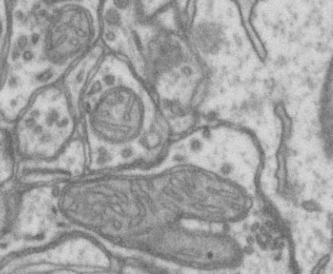
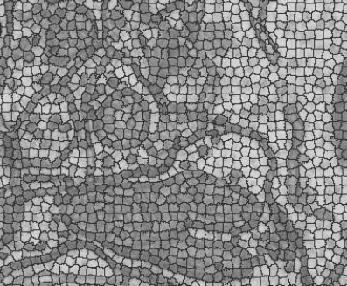
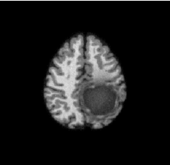
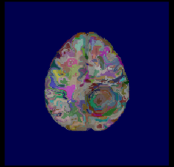
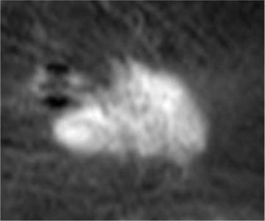
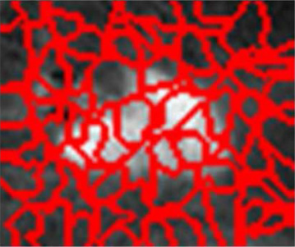
Introduction: Superpixels
electron microscope image
Advantages of superpixels:
Adhere local boundaries
Enrich features
Narrow down valid regions for pixel-level refinement
brain T1 MRI
breast tumor DCE-MRI
Notes:
The proposed work was inspired by the concept of superpixels that aggregate nearby pixels with similar intensities together to more compactly represent images.
The examples of superpixels are separately generated on the electron microscope image, brain T1 MRI, and breast tumor DCE-MRI.
We here considers three advantages of superpixels:
They efficiently adhere local boundaries while satisfying spatial constraints;
They enrich features more than intensity features, but also include textural features and geometric features;
After superpixel-level pre-segmentation, the interesting superpixels narrow down the valid regions for the following pixel-level refinement.

Slide 5
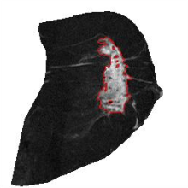
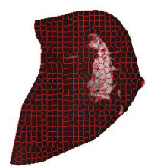
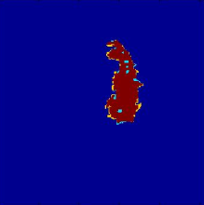
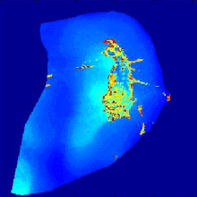
Framework
(d) pre-segmentation result
(a) input subtraction image
(b) smoothing image
(c) superpixels
mean-shift smoothing
SLIC algorithm
AdaBoost classification
ground truth
zoom-in
over-segmentation prior knowledge
final segmentation
morphological opening and closing
data term
mincut-maxflow algorithm
(h) overlap between final segmentation and ground truth
(g) refinement result
(f) graph-cuts partitioning result
(e) probability map of tumor GMM
Notes:
Given a subtraction image, our automatic segmentation framework incorporates mean-shift smoothing, superpixel generation, superpixel-level classification, pixel-level graph-cuts partitioning, and morphological refinement .

Slide 6
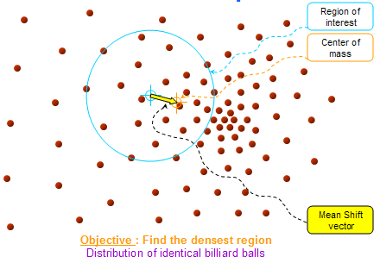
Mean-shift Smoothing
Mean-shift filter: edge-preserving smoothing
mean-shift filter
input subtraction image
smoothing image
Notes:
A mean-shift smoothing filter is first applied to minimize the artifacts introduced by MR imaging. Unlike traditional filters, a mean-shift filter is a discontinuity-preserving smoothing approach which adaptively decreases the amount of smoothing near edges and preserves local structure.
(1 min)

Slide 7
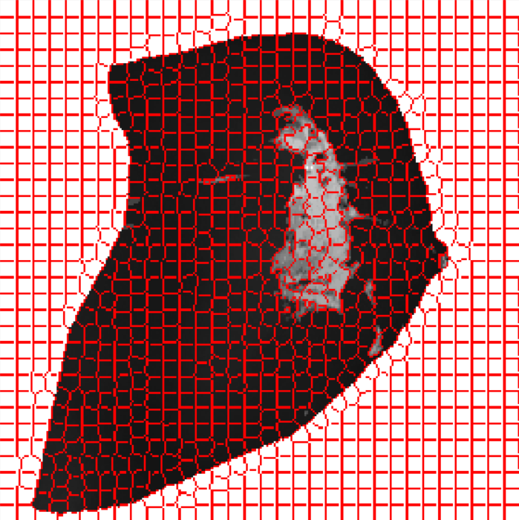
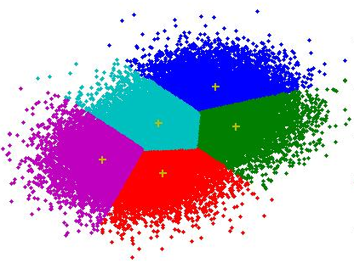
Superpixel Generation
SLIC: a spatially-localized version of k-means clustering
SLIC
smoothing image
superpixels
Notes:
After smoothing, a Simple Linear Iterative Clustering (SLIC) algorithm is used to generate superpixels.
It is a spatially-localized version of k-means clustering that aggregates together pixels sharing similar appearances in the joint domain of spatial coordinates and gray-level intensities.
Compared with other superpixel generation methods like those normalized-cuts-based and graph-merging-based algorithms, SLIC is faster, adheres to boundaries better, and generates superpixels with more identical sizes to be more suitable for scale-variant feature representation.
(1 min)

Slide 8
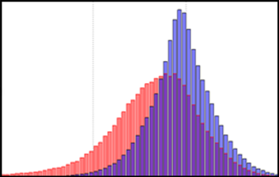
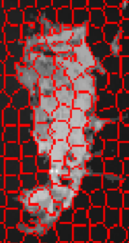
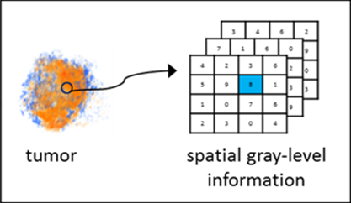
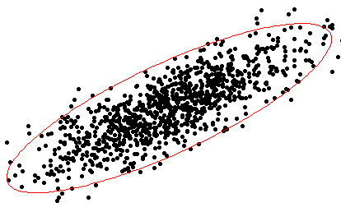
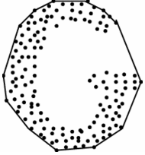
Feature Exaction
Statistical intensity features:
intensity (gradient) mean, std, skewness, kurtosis, range, entropy, and histogram
Textural (Haralick) features:
contrast, correlation, energy and homogeneity of co-occurrence matrices
Geometric features:
compactness
irregularity
axis ratio (ellipse)
eccentricity (ellipse)
solidity (convex hull)
Notes:
In order to try to robustly distinguish tumor regions from others, we extract three types of features from each superpixel: intensity, textural, and geometric features.
Intensity features are used to potentially distinguish enhanced tumor regions from dark background.
Textural features are used to potentially distinguish more uniform tumor regions from fibroglandular tissues with complicated texture.
Geometric features are used to potentially distinguish compact tumor regions from narrow blood vessels.
(2 min)

Slide 9
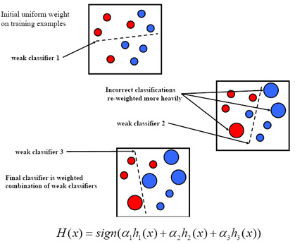
Adaboost Classification
Adaboost classifier:
a linear combination of complementary binary decision trees
pre-segmentation
Notes:
After feature extraction, we train an Adaboost classifier in the feature space, which is composed of binary decision trees as complementary weak classifiers.
Then those testing superpixels containing tumor are identified and selected as shown in the pre-segmentation.
(1 min)

Slide 10
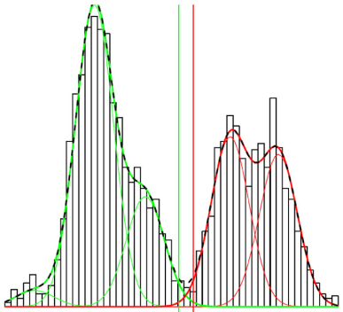
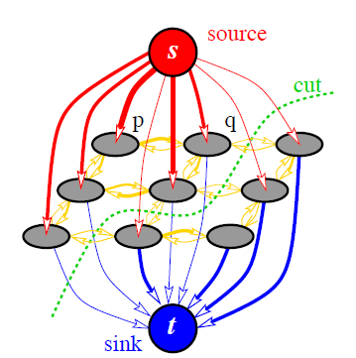
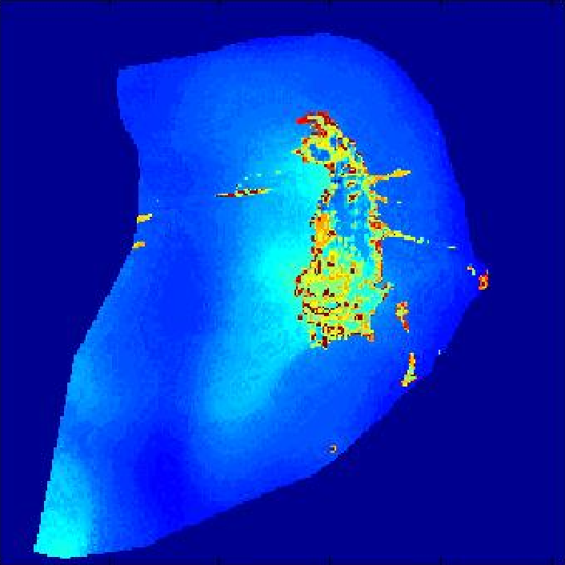
Pixel-Level Graph-Cuts Partitioning
GMM
mincut-maxflow algorithm
tumor probability
Notes:
Considering the robustness of the automatic framework, within the superpixel-level pre-segmentation, we further perform pixel-level refinement.
The refinement is a partitioning problem formulated as a graph-cuts model.
The graph-cuts model is to minimize an energy function composed of two terms: the data term and the smoothness term.
The data term is related with the probability of a pixel to be labeled as tumor or not, which comes from the GMM estimation in the gray-level intensity space.
The smoothness term constrains the labels of two adjacent pixels, which penalizes the pair of pixels with different labels.
Then the energy function is minimized by the mincut-maxflow algorithm.
(1 min)

Slide 11
Morphological Refinement
morphological opening
Notes:
In the final step, a morphological opening operation is performed to eliminate tiny outliers and noise.
(1 min)

Slide 12
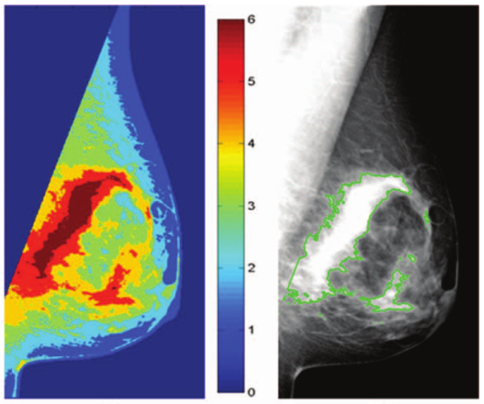
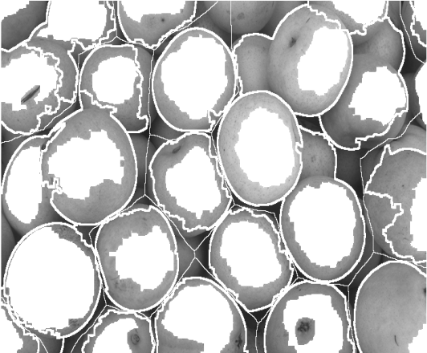
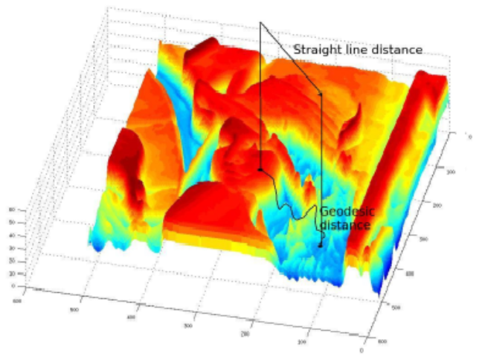
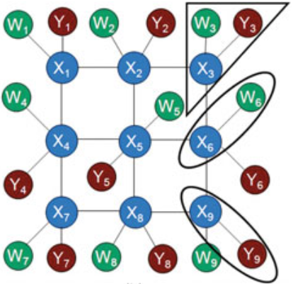
Experiments
Dataset: 15 women’s T1-weighted fat-suppressed sagittal DCE-MRI from the ACRIN 6657 I-SPY trial
Ground truth: performed by a board-certified breast imaging radiologist using the ITK-SNAP
Method | Model | Characteristic
AdaFCM | pixel-wise clustering + classification | automatic, supervised
Marker-controlled watershed | GMM + thresholding+ watershed | automatic, unsupervised
Adaptive geodesic transformation | landmark-based geodesic map + thresholding | semi-automatic, unsupervised
Superpixel-based MRF | superpixel + MRF + LBP | automatic, supervised
The proposed framework | superpixel-based classification + graph-cuts | automatic, supervised
AdaFCM
watershed
geodesic
superpixel + MRF
Notes:
Adaptive fuzzy c-means is an adaptive strategy to select N-highest-intensity FCM clusters as tumor regions via a binary tumor-vs-non-tumor classifier.
Marker-controlled watershed segmentation applies watershed transformation on the gradient image superimposed with markers, which are automatically selected from two GMM-based thresholds.
Adaptive geodesic transformation is based on the geodesic distance map where intensity and gradient information are fused for geodesic transformation. It is adapted by the spatial variance of gradient weights according to expert landmarks. As a result, it is semi-automatic because of manually-initialized landmarks and the seeds inside tumor.
Superpixel-based MRF models the topology of superpixels as a multi-channel Markov random field and converges the superpixel labeling through loopy belief propagation (LBP).

Slide 13
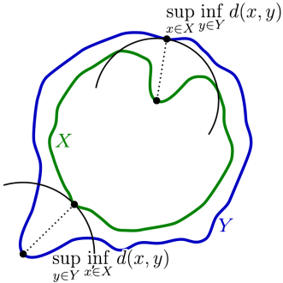
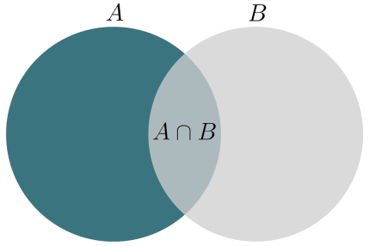
Results
The proposed framework consistently outperforms the other four methods based on Dice Similarity Coefficient (DSC) and Mean Hausdorff Distance (MHD).
Method | DSC | MHD
AdaFCM | 0.72±0.27 | 2.52±7.98
Marker-controlled watershed | 0.65±0.24 | 4.51±12.63
Adaptive geodesic transformation | 0.78±0.14 | 1.67±2.71
Superpixel-based MRF | 0.69±0.17 | 2.64±3.02
The proposed framework | 0.83±0.12 | 0.79±1.43
Notes:
Moreover, the proposed framework performs most robustly on diverse samples as evidenced by the relatively small standard deviations in both metrics.
Note that the second best method, adaptive geodesic transformation, is a semi-automated algorithm in which results are dependent on the precision of manual initialization.

Slide 14
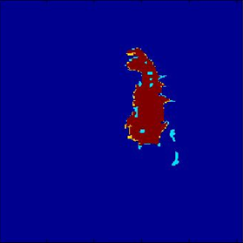
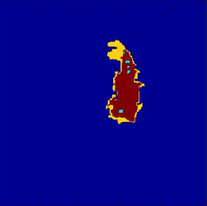
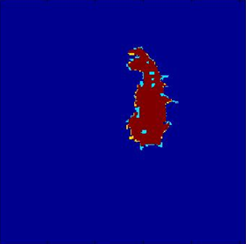
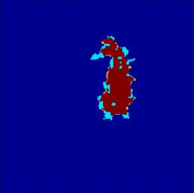
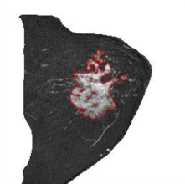
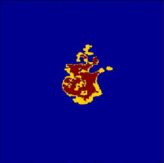
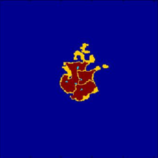
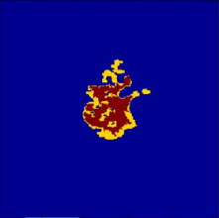
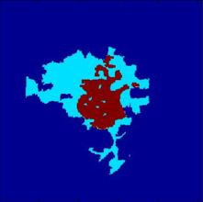
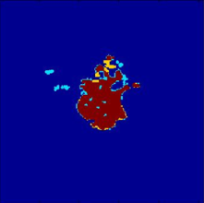
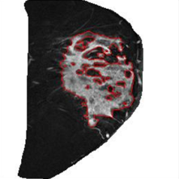
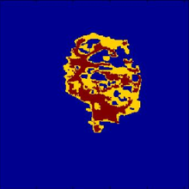
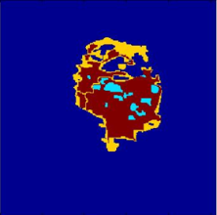
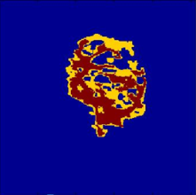
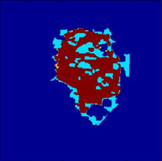
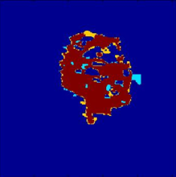
Results
Red – overlap between ground truth and segmentation result
Yellow – under-segmentation
Cyan – over-segmentation
DSC: 0.9238
DSC: 0.8109
DSC: 0.9348
DSC: 0.8659
DSC: 0.9443
DSC: 0.7107
DSC: 0.7731
DSC: 0.7137
DSC: 0.4932
DSC: 0.8873
DSC: 0.6360
DSC: 0.7735
DSC: 0.6983
DSC: 0.8173
DSC: 0.9177
input images and ground truths
AdaFCM
marker-controlled watershed
adaptive geodesic transformation
superpixel-based MRF
the proposed framework
Notes:
When tumors appear to be irregular and heterogeneous, only the proposed framework could capture both the overlap and boundaries adequately.
The reasons are:
The AdaFCM model only considers intensity information, but ignores spatial information.
The marker-controlled watershed model is sensitive to the selection of foreground and background markers, which are the thresholding results from GMM working only on the intensity histogram.
The adaptive geodesic transformation model largely depends on the manual initialization.
The superpixel-based MRF model has a too strong connectivity constraints based on the information propagation scheme.

Slide 15
Future Work
Incorporate superpixels into graph-cuts model
while considering to combine together multiple similarities in different feature spaces so as to best reflect underlying information.
+
graph-cuts
superpixels
Notes:
We conclude that in our work, an automatic tumor segmentation framework is developed and validated, which leverages intensity, textural and geometric information of superpixels for use in breast DCE-MRI. The proposed framework consistently outperformed four basic segmentation methods in terms of superior capture of the overlap and boundaries of the tumors.
Our future work may include incorporating superpixels into graph-cuts model, but we need to figure out how to combine together multiple similarities in different feature spaces, so as to best reflect underlying information.

Slide 16
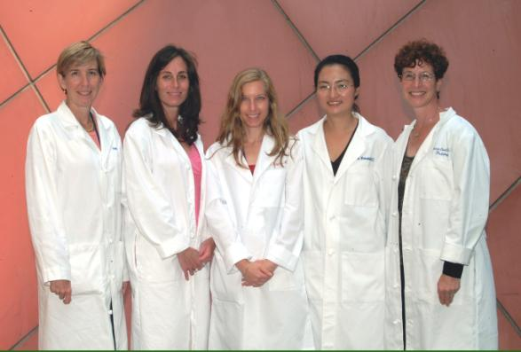
Breast Imaging Division
Emily F. Conant MD
Susan P. Weinstein MD
Elizabeth McDonald MD PhD
CBIG Lab Members
Despina Kontos PhD
Brad Keller PhD
Jia Wu PhD
Majid Mahrooghy PhD
Shonket Ray PhD
Lin Chen PhD
Aimilia Gastounioti PhD
Ning Yu MSc
Andrew Oustimov MPH
Lauren Pantalone BS
Amanda Shacklett MS
Paraskevi Parmpi MS
Collaborators
Mitchell D. Schnall MD PhD
Christos Davatzikos PhD
Mark A. Rosen MD PhD
Angela DeMichele MD
James C. Gee PhD
Katrina Armstrong MD
Lewis Chodosh MD PhD
Susan M. Domchek MD
David Mankoff MD PhD
Michael Feldman MD PhD
Katie Schmitz PhD MPH
Affiliated Clinical Trainees
Michael Deleo MD
Jenny Rowland MD
Dania Daye MD PhD
Tim Carlon MDc
Funding
NIH/NCI (R01, U54, R21)
American Cancer Society
Susan G. Komen for the Cure
Basser Research Center
Penn ITMAT, CBICA
Affiliated Research Staff
Michael Hsieh MS
Yuanjie Zheng PhD
www.uphs.upenn.edu/radiology/research/labs/cbig/

Slide 17
Q&A
Thanks for your attention!

